Slide 1
Chapter 2. Personality
Theories of personality,
Assessment of Personality

Slide 2
Early Trait Theories
The trait approach to personality is one of the major theoretical areas in the study of personality
Trait approaches have tried to identify the most basic and relatively enduring dimensions along which people differ from one another--dimensions known as traits.
Trait approach to personality is focused on differences between individuals
It is focused on identifying and measuring these individual personality characteristics.
Trait
A trait is a stable personality characteristic
(Cacioppo & Freberg, 2013)

Slide 3
Trait Theories
1. Gordon Allport’s Trait Theory (not included in your syllabus)
2. Raymond Cattell’s Sixteen Personality Factor (not included in your syllabus)
3. Eysenck’s Three Dimensions of Personality
4. The Big Five Theory/ Five-Factor Model

Slide 4
2. Raymond Cattell’s Sixteen Personality
Factor (16-PF) (slide not included in syllabus)
Trait theorist Raymond Cattell reduced the number of main personality traits from All port’s initial list of over 4,000 down to 16
by means of a statistical technique called factor analysis

Slide 5
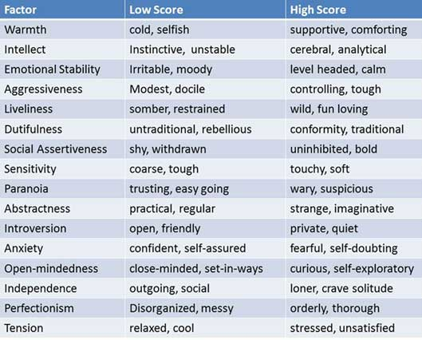
Cattell’s 16-PF

Slide 6
3. Eysenck’s Three Dimensions
(PEN Model) of Personality
PEN model is a biological theory of personality developed by influential psychologist Hans Eysenck (1916-1997). The model focusses on three broad personality factors: Psychoticism, Extraversion and Neuroticism (PEN).
Prior to developing the PEN model, Eysenck sought to measure personality based on two dimensions: extraversion-introversion and neuroticism-emotional stability.

Slide 7
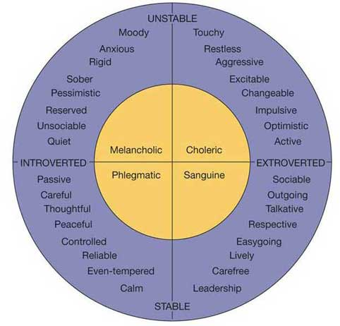
Eysenck’s Three Dimensions (PEN Model) of Personality
Hans Eysenck:
found two (2) major
trait dimensions:
  Introversion
  versus
  extroversion/ extraversion
  (quiet versus sociable).
  Neuroticism
  versus
  emotional stability
  (moody versus calm).

Slide 8
Eysenck’s Three Dimensions of Personality
Extroverts are sociable and crave excitement and change, and thus can become bored easily. They tend to be carefree, optimistic and impulsive. They are more likely to take risks and be thrill seekers. Eysenck argues that this is because they inherit an under aroused nervous system and so seek stimulation to restore the level of optimum stimulation.
Introverts on the other hand lie at the other end of this scale, being quiet and reserved. They are already over-aroused and shun sensation and stimulation. Introverts are reserved, plan their actions and control their emotions. They tend to be serious, reliable and pessimistic.

Slide 9
Eysenck’s Three Dimensions of Personality
Neuroticism/ Emotionally Instable
It is characterized by perfectionism, and a tendency to feel dissatisfied, angry or frustrated with others when their desires are not fulfilled, or when their expectations are not met.
Individuals scoring high on neuroticism measures tend to experience higher levels of stress and anxiety. They worry about relatively insignificant matters, exaggerating their significance and feeling unable to cope with life stressors.
Emotionally Stable
A person with a low neuroticism score will generally experience more emotional stability. They feel more able to cope with stressful events and set less stringent demands of themselves.
Individuals with a low level of neuroticism are more tolerant of the failings of others and remain more calm in demanding situations.

Slide 10
Eysenck’s Three Dimensions of Personality
Psychoticism vs Normality (low psychoticism)
Eysenck (1966) later added a third trait / dimension -Psychoticism – e.g., lacking in empathy, cruel, a loner, aggressive and troublesome. Individuals with higher psychoticism scores are more likely to engage in irresponsible or miscalculated behavior. They may also contravene accepted social norms and be motivated by a need for immediate gratification, regardless of its consequences.

Slide 11
4. The Big-Five Theory/ Five-Factor Model
Presented by McCrae and Costa in1987
Many researchers felt that Cattell's theory was too complicated and Eysenck's was too
limited in scope. As a result, the five-factor theory emerged to describe the essential
traits that serve as the building blocks of personality.
The five broad personality traits described by the theory are extraversion (also often spelled extroversion), agreeableness, openness, conscientiousness, and neuroticism.

Slide 12
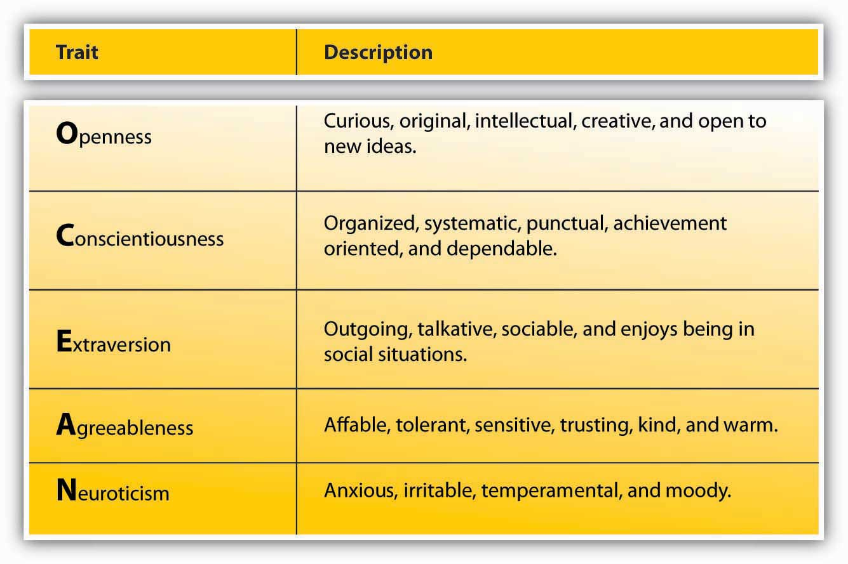
The Big-Five Theory/ Five-Factor Model

Slide 13
Personality Assessment
1. Non-projective Tests
2. projective Tests
Non-projective personality tests also known as objective personality tests, present the participant (test taker) with a number of specific items to which he/she is asked to respond, either on paper or on a computer screen.
Projective tests ask participants to respond to vague, ambiguous stimuli in ways that may reveal the subject’s needs, feelings, and personality traits.

Slide 14
Personality Assessment
Non-projective Tests
Projective tests
Personality inventories like
Minnesota Multiphasic Personality Inventory (MMPI) by Hathaway & McKinely
The California Personality Inventory (CPI) by Harrison Gough
Interview
Rorschach Ink-blot Test (RIT) by Rorschach
Thematic Apperception Test (TAT) by Morgan & Murray (1935)
House Tree Person (HTP) by John Buck 1948
Word Association Test (WAT) by Kent Rosenoff,

